Slide 1
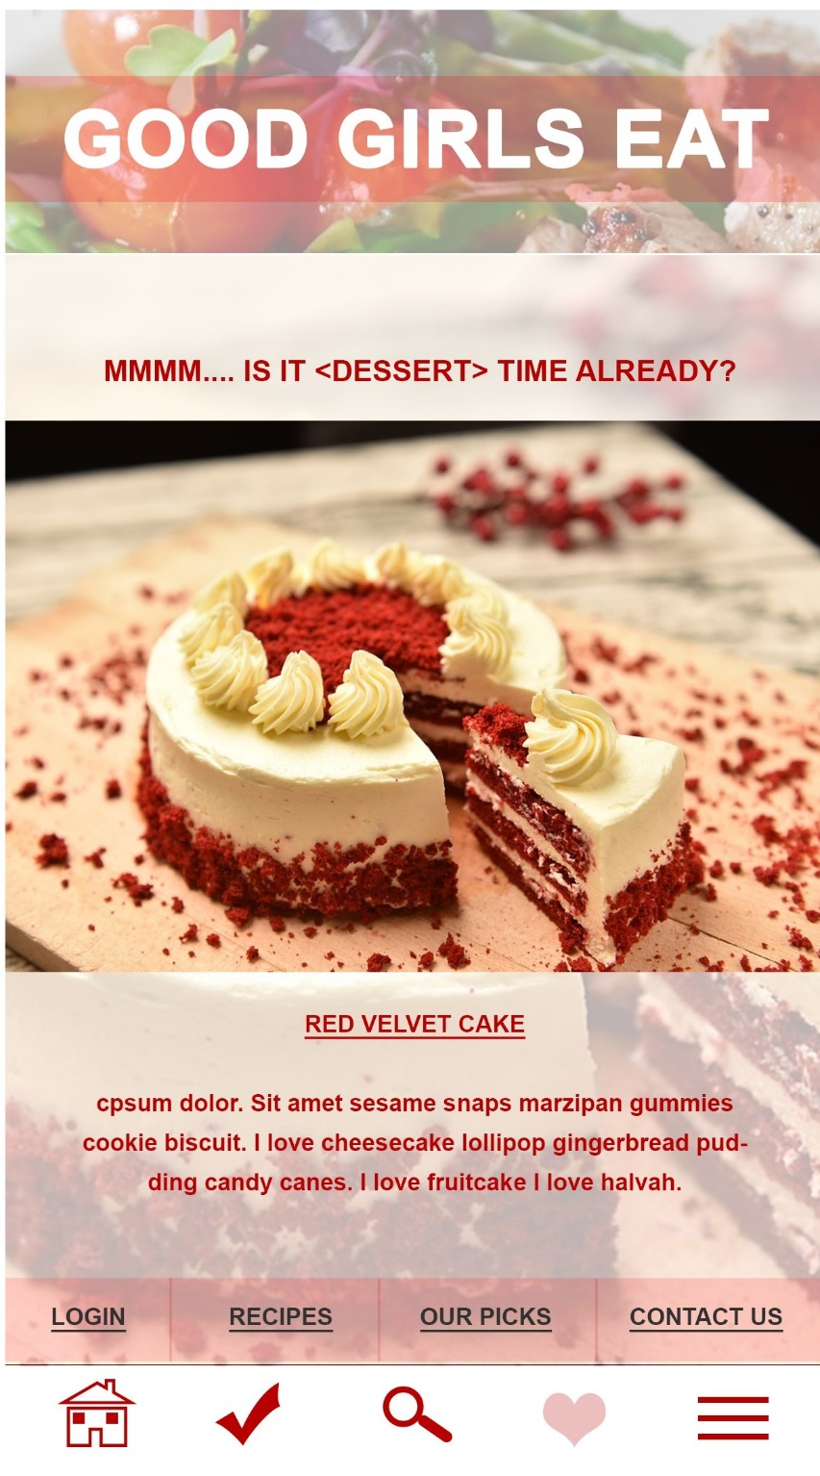
Header Component. MainHeader.
Background Image Component for header. Example of salad image with tomato here. BgHeader.
Title Props in text to describe the “page”. Eg, GOOD GIRLS EAT. TitleHeader.
Title text itself. GOOD GIRLS EAT in white.
GOOD GIRLS EAT
Titles can be changed:
GOOD RECIPES
GOOD GIRLS FAVES
MY FAVES
Legend:
Bold = Component defined
Blue Text = Component name (based on Class).
Background colour associate: With the same components.

Slide 2
Footer Component. Footer
Home Component
Favourite Component
Search Component
Recipes Component
HomeButton Home Logo→ when clicked will lead to the homepage
RecipeButton
Recipe Logo → when clicked will lead to a recipe page/Card
FavButton
Favourite Logo→
When clicked will lead to user own liked recipes
SearchButton
Search Logo → when clicked will lead to a search page
Hamburger Component
Refer to hamburger component page for further details.

Slide 3
Hamburger Component.
Hamburger
Note: Only occur when user is not logged in
Login/Logout/Signup (user account) Component
Recipes Component
Contact Us
Component
RecipeButton
Recipe Logo → when clicked will lead to a recipe page
ContactUs →
When clicked will lead the user to Contact Us page form.
UserAcc→
When clicked will lead the user to login/logout/signup page.
Good Girl Recommend Component
GirlRec→
When clicked will lead the user to Good Girl Recommend Page.
Corinna noted: This to be stored in main store.

Slide 4
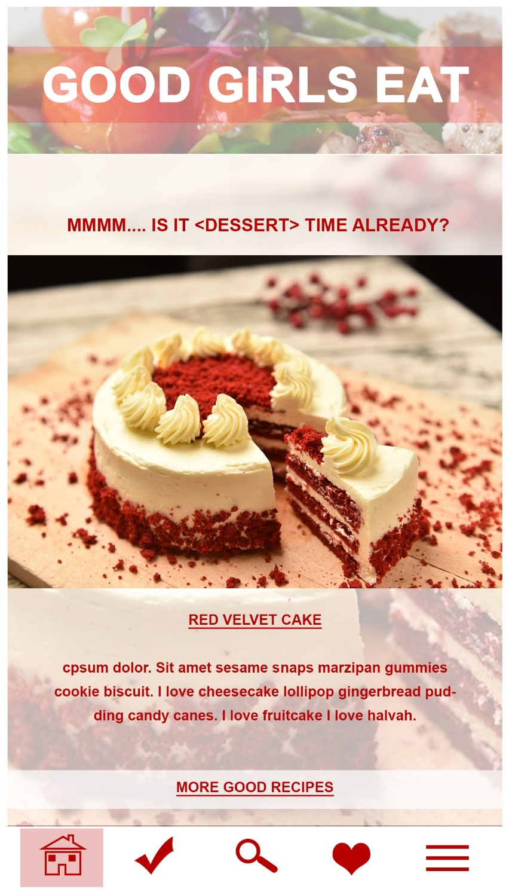
Props Time Function.
ItIsTimeGallery
Recipe Gallery Component
RecGallery
Background Image Component. BgHeader.
Recipe Image Gallery Component
RecPicGallery.
Recipe Gallery Title Props.
RecTitleGallery
Recipe Gallery Summary Props.
RecSumGallery
Team Notes from Corinna: Time determined recipes (rotates through a couple of choices each) – Local storage of data, breakfast, lunch, supper, dessert.

Slide 5
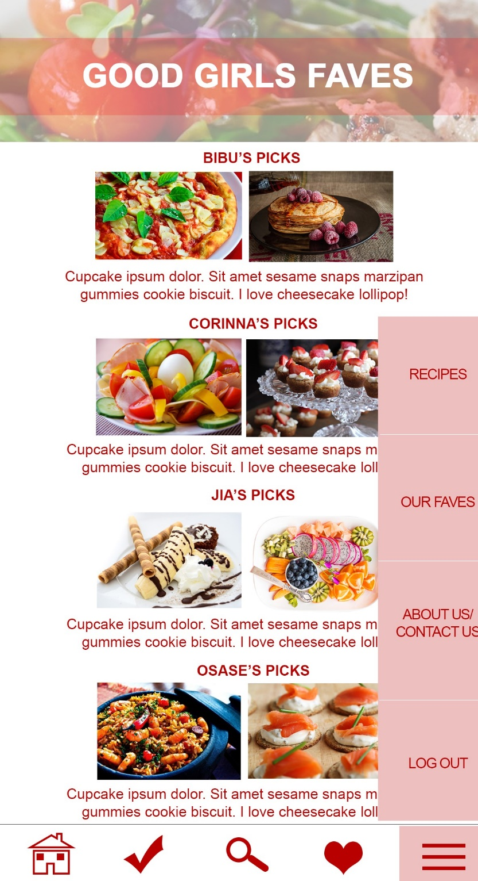
Good Girls Faves Component.
GirlRec
Our Name Picks Array. OurName
Top 2 picks (?) of our favourite recipes. Displayed as a list.
Recipe Image Component
RecPic. Refer to My Food Card Component page.
Summary Description Component. SumPick.
Our Name are Bibu, Osase, Jia, and Corinna.
Description of why these recipes were picked
Displays the image of the recipe.
When display image click, will lead user to the recipe page.

Slide 6
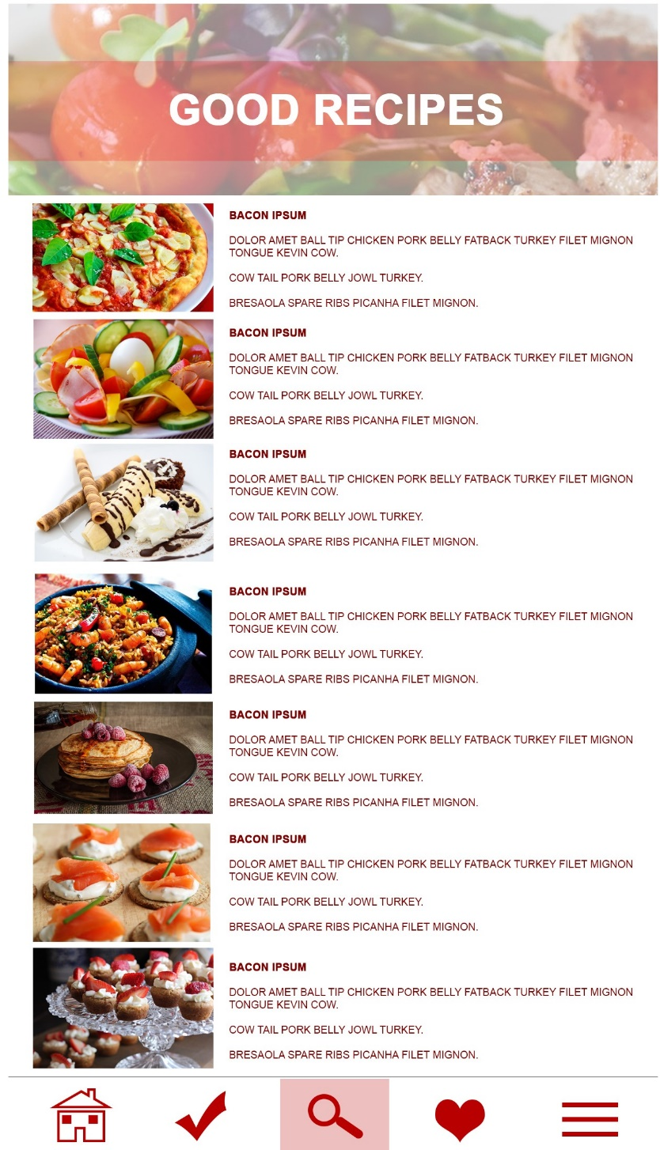
My Food Card Component (User Favourited Recipes)
MyFavRec
Recipe Image Component
RecPic.
Recipe Title. RecTitle
Recipe Summary.
RecSum
Displays the image of the recipe.
Displays the title of the recipe
Displays the summary of the recipe
When user go from mainpage/hamburger to this.

Slide 7
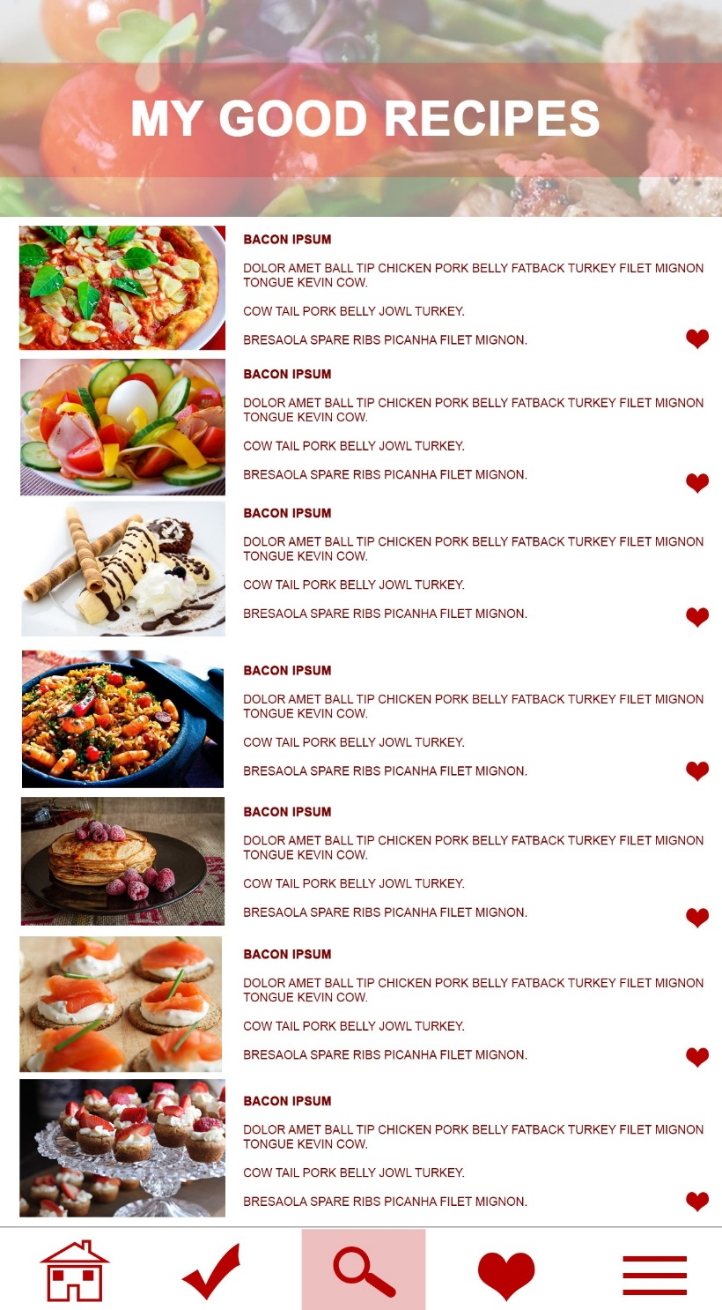
My Food Card Component (User Favourited Recipes)
MyFavRec
Recipe Image Component
RecPic.
Favourited Recipe Displayed in a list
Recipe Title. RecTitle
Recipe Summary Component.
RecSum
Favourite Logo Prop.
FavCheckbox
Displays the image of the recipe.
Displays the title of the recipe
Displays the summary of the recipe
Display liked or not liked like a To-Do list
When display image click, will lead user to the recipe card page.

Slide 8
My Food Card Component (User Favourited Recipes)
MyFavRec
Recipe Summary Component.
RecSum
Recipe Image Component
RecPic. Refer to My Food Card Page
Recipe Title.
RecTitle
Displays the summary of the recipe
Displays the image of the recipe.
Displays the title of the recipe
Search Result Component
RecResult
When display image click, will lead user to the recipe page.
Display results such as “the result of beef returns 6 recipes”

Slide 9
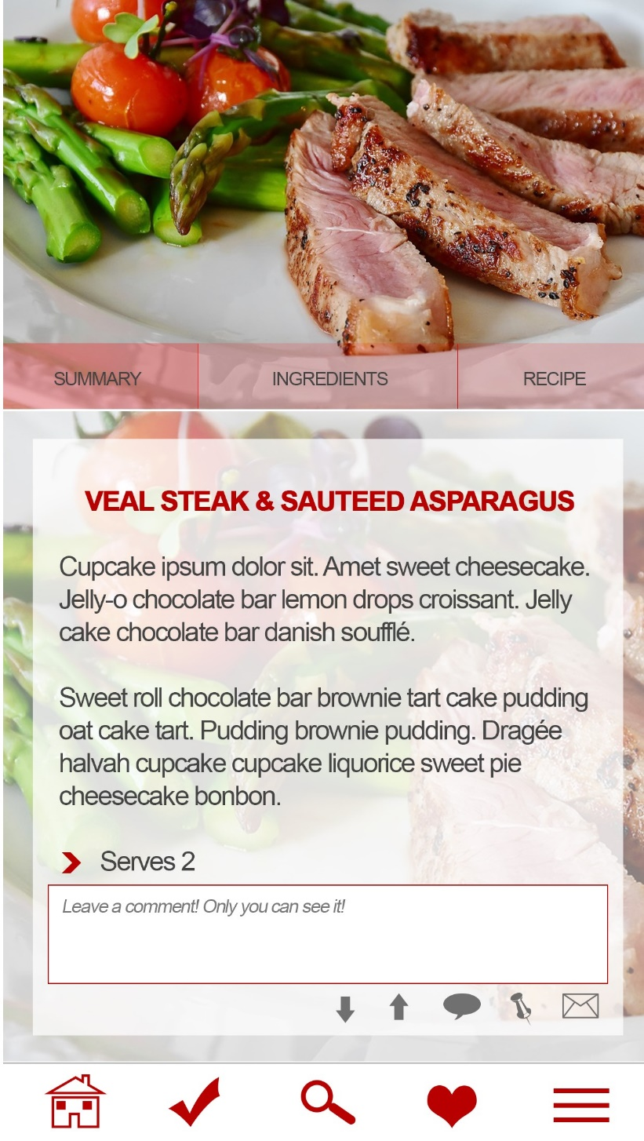
Recipe Nav Bar Component
RecNav
Summary Button
SumButton
Ingredients Button
IngButton
Recipe Button
RecButton
Background Image Component for header. Example of salad image with tomato here. BgHeader.
When clicked will lead to Summary Component/
Page
Summary Component
CardSum
When clicked will lead to Ingredients Component/
Page
Ingredients Component
CardIngredients
When clicked will lead to Recipe Component/
Page
Recipe Component
CardRec

Slide 10
Summary Card Component
CardSum
Recipe Nav Bar Component
RecNav
Card Email Component
CardEmail
Title Recipe Card Prop.
CardTitle
Comment Form Component
CardComment
Summary Prop
CardSum
Upvote CardUp
Downvote CardDown
For user to input comment when comment logo is clicked (?) *Clarify with team.
Tally of the vote
Serving Card Prop
CardServe
Fav Card Component
CardFav
Background Image Component for header. Example of salad image with tomato here. BgHeader.

Slide 11
Summary Card Component
CardSum
Title Recipe Card Prop.
CardTitle
Ingredients Prop
IngProp
List of ingredients in unordered list (Osase comments)
Ingredient Page

Slide 12
Summary Card Component
CardSum
Title Recipe Card Prop.
CardTitle
Recipe Prop
RecProp
List of ingredients in unordered list (Osase comments)
Recipe page

Slide 13
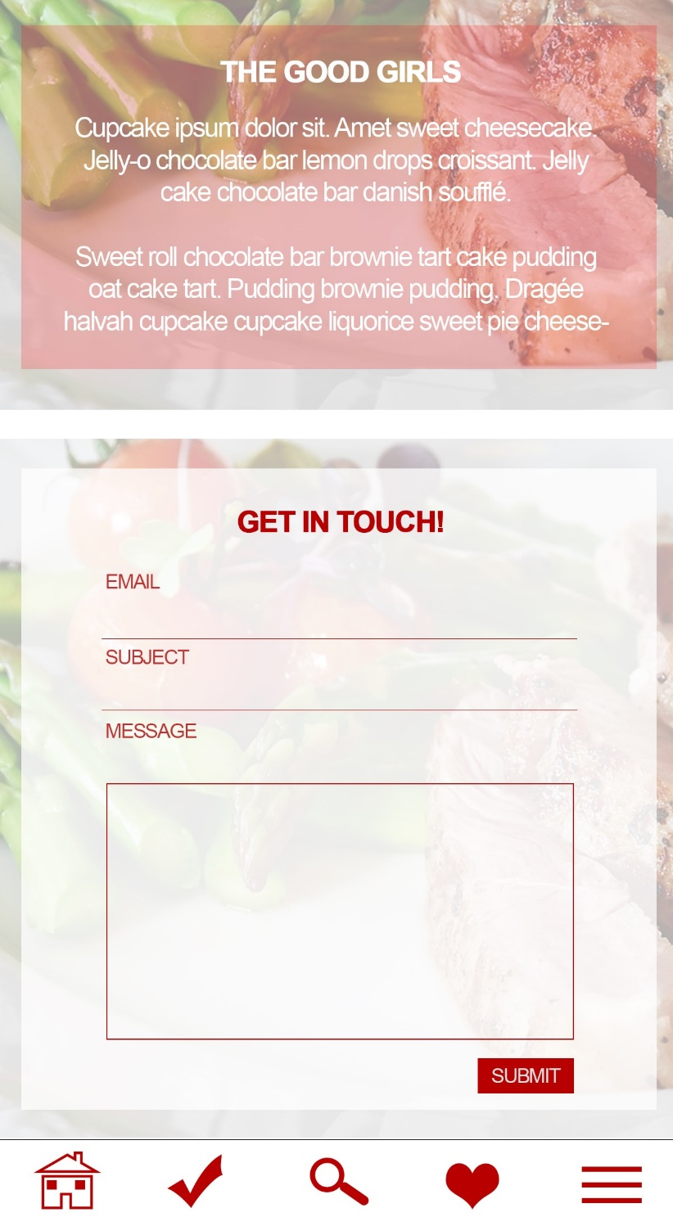
The Good Girls Summary Component GirlsSummary
Background Image Component for header. Example of salad image with tomato here. BgHeader. Refer to page 1.
Summary Text of The Good Girls
Input Form
InputForm
Message Input
Submit Button
Subject Input
Email Input
Contact Us Component
ContactUs
Submit Button
SubButton
Get In Touch Title
Note: Have to decide whether input form is a component

Slide 14
Hamburger Component.
Hamburger
About Us Component
Good Girls Faves Component
Recipes Component
Login/Logout/Signup (user account) Component
AboutUs →
When clicked will lead the user to About Us page.
OurPicks →
When clicked will lead the user to Our Picks page.
GirlRec→
When clicked will lead the user to Good Girls Faves Component.
UserAcc→
When clicked will lead the user to login/logout/signup page.
Corinna noted: This to be stored in main store.
Corinna noted: This to be stored in main store.

